Slide 1
Demographic Data

Slide 2
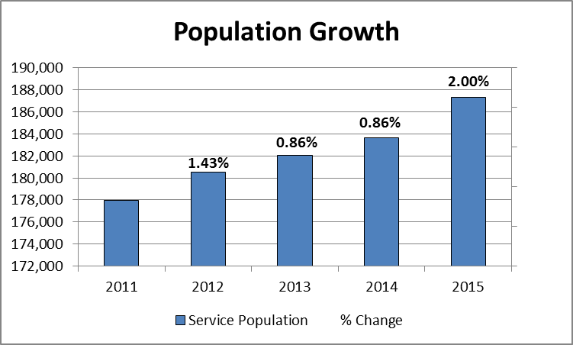
Demographic Data
Estimate
BEBR - http://www.bebr.ufl.edu/population/data

Slide 3
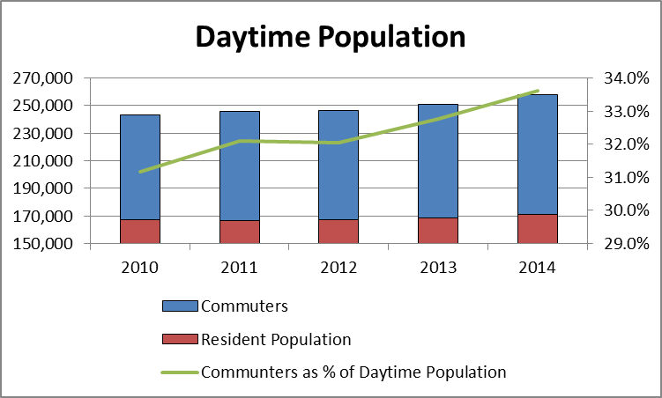
Demographic Data
Estimate
Broward County - https://www.broward.org/PlanningAndRedevelopment/DemographicsAndEconomics/Documents/BBTN60.pdf

Slide 4
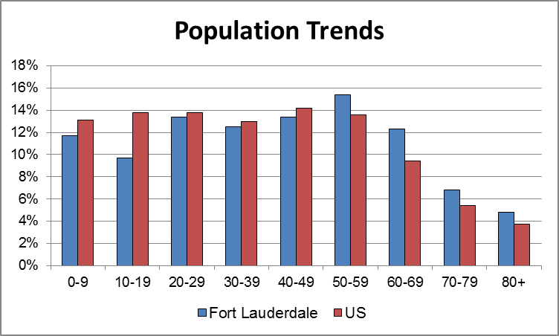
Demographic Data
US Census Data - http://factfinder.census.gov/faces/nav/jsf/pages/community_facts.xhtml?src=bkmk

Slide 5
Seasonality

Slide 6
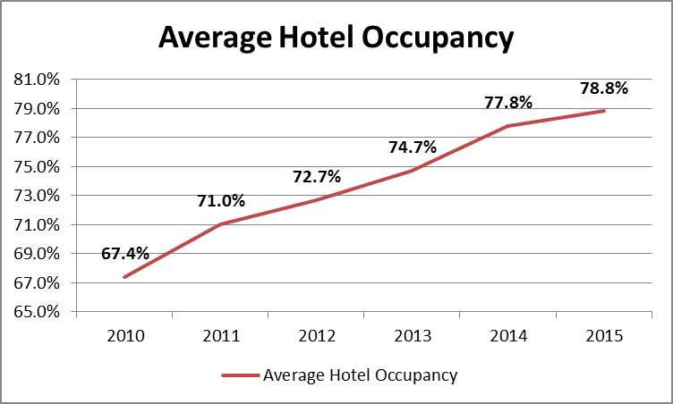
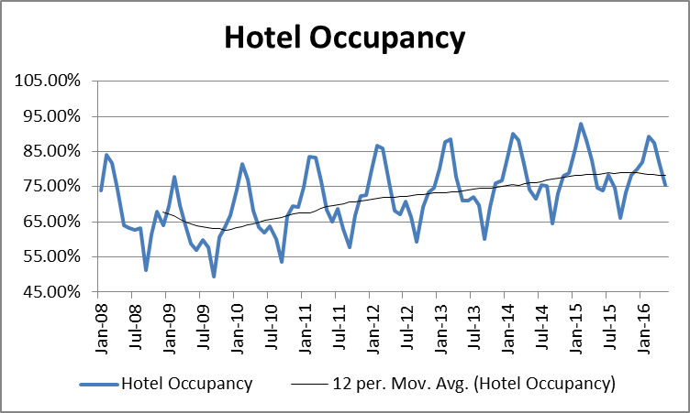
Seasonality
Hotel Occupancy - https://www.sunny.org/vital-stats/

Slide 7
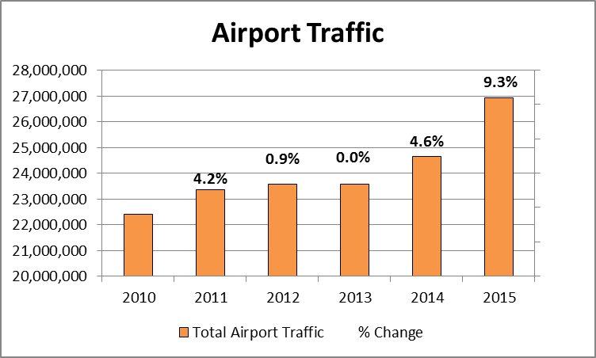
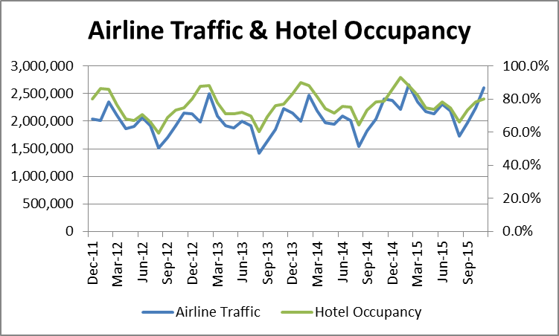
Seasonality
Airport Traffic - http://www.broward.org/Airport/About/Pages/Statistics.aspx

Slide 8
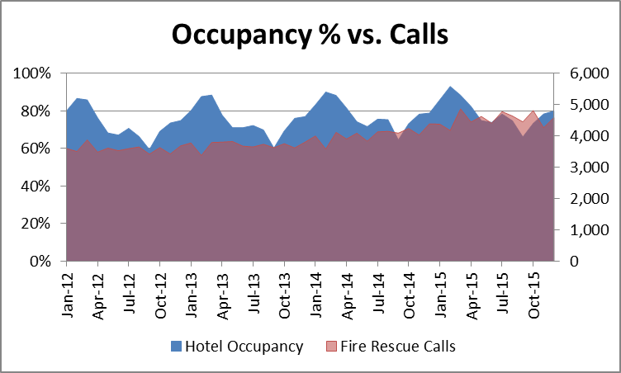
Seasonality

Slide 9
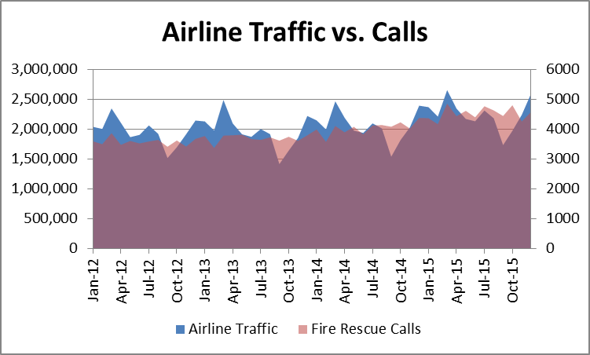
Seasonality

Slide 10
FireRMS Call Volumes

Slide 11
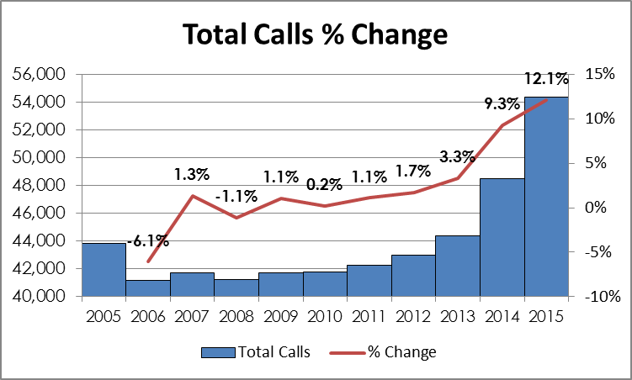
FireRMS Call Volumes

Slide 12
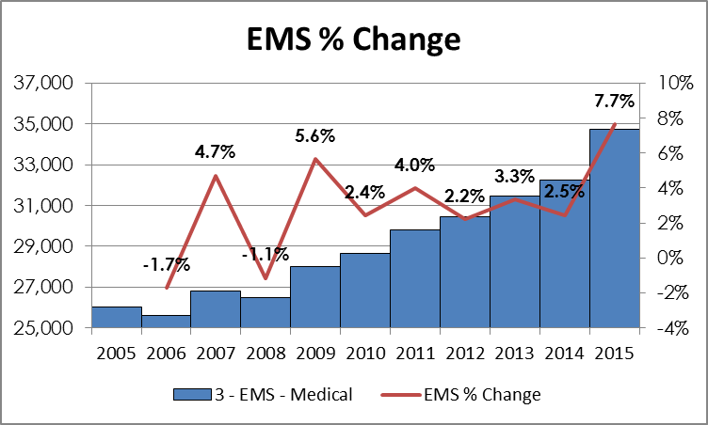
FireRMS Call Volumes

Slide 13
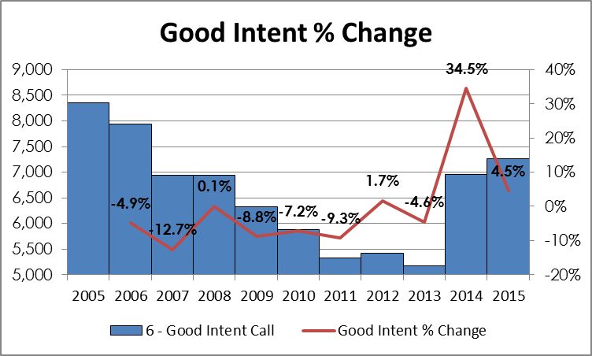
FireRMS Call Volumes

Slide 14
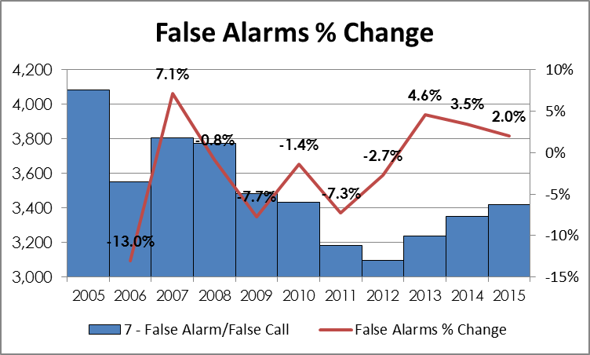
FireRMS Call Volumes

Slide 15
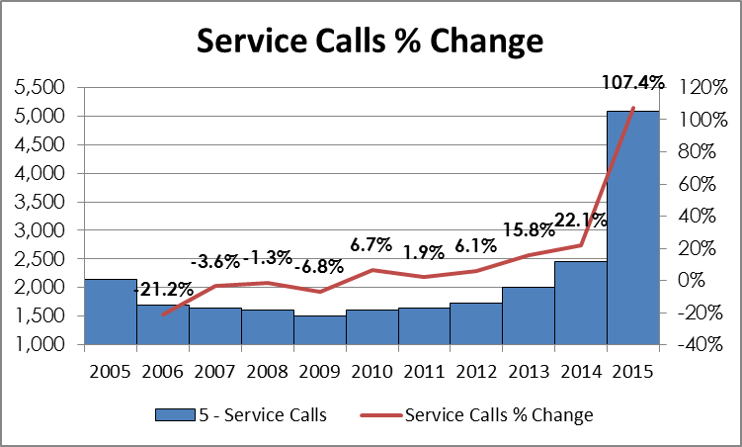
FireRMS Call Volumes

Slide 16
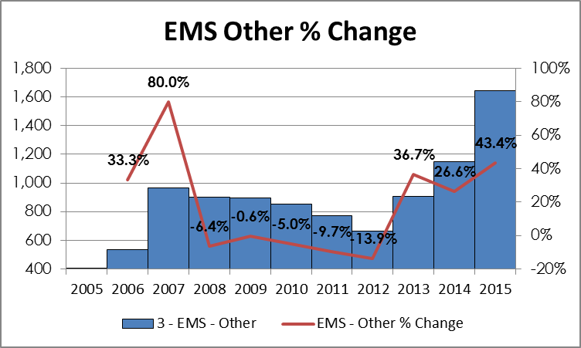
FireRMS Call Volumes

Slide 17
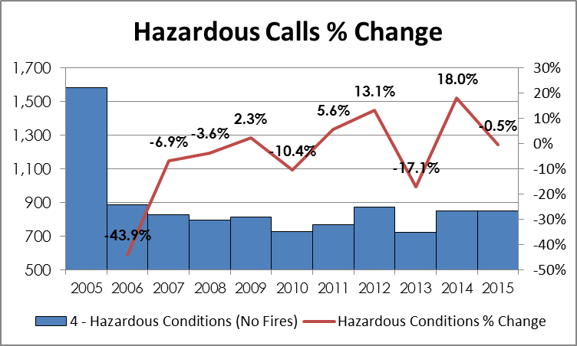
FireRMS Call Volumes

Slide 18
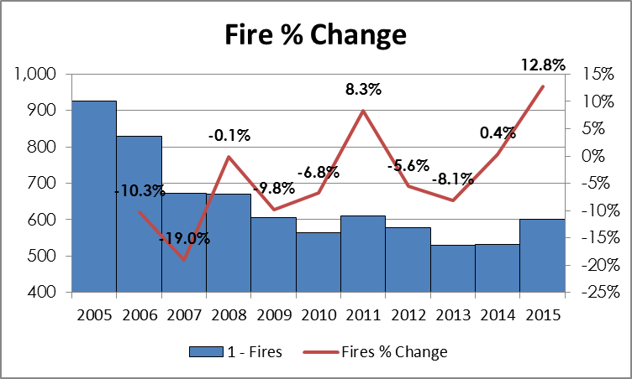
FireRMS Call Volumes

Slide 19
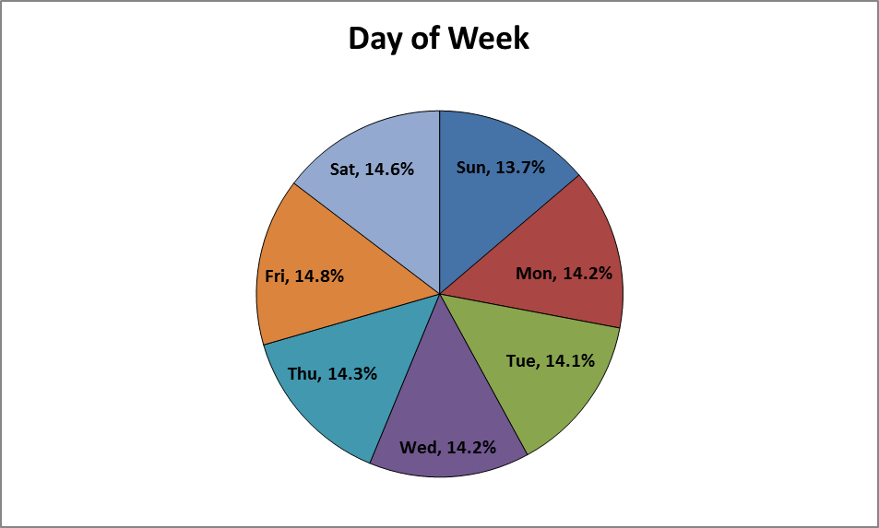
FireRMS Call Volumes

Slide 20
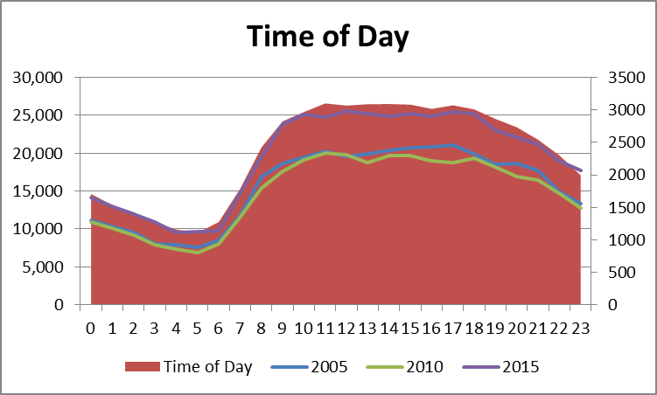
FireRMS Call Volumes

Slide 21
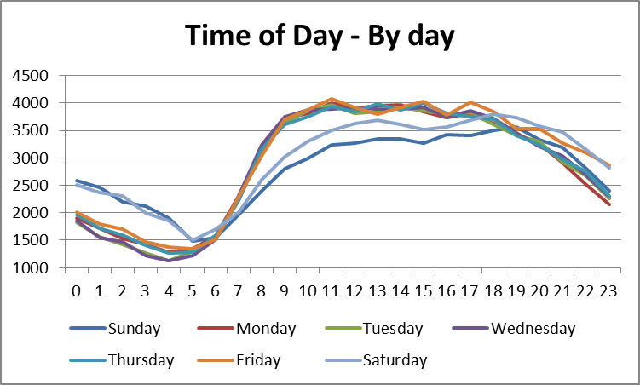
FireRMS Call Volumes

Slide 22
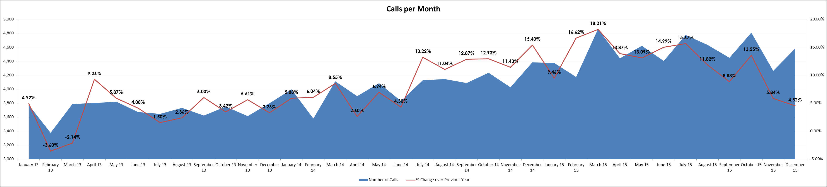
FireRMS Call Volumes
Regional Dispatch begins
Notes:
Never above 10% increase until July 14

Slide 23
FireRMS Call Volumes – Zoning

Slide 24
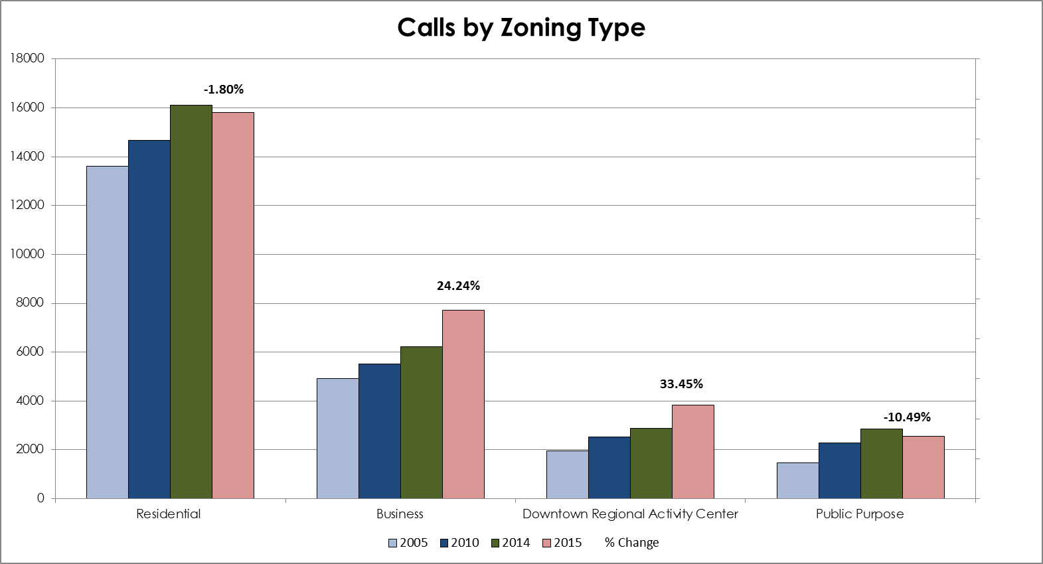
FireRMS Call Volumes – Zoning Type

Slide 25
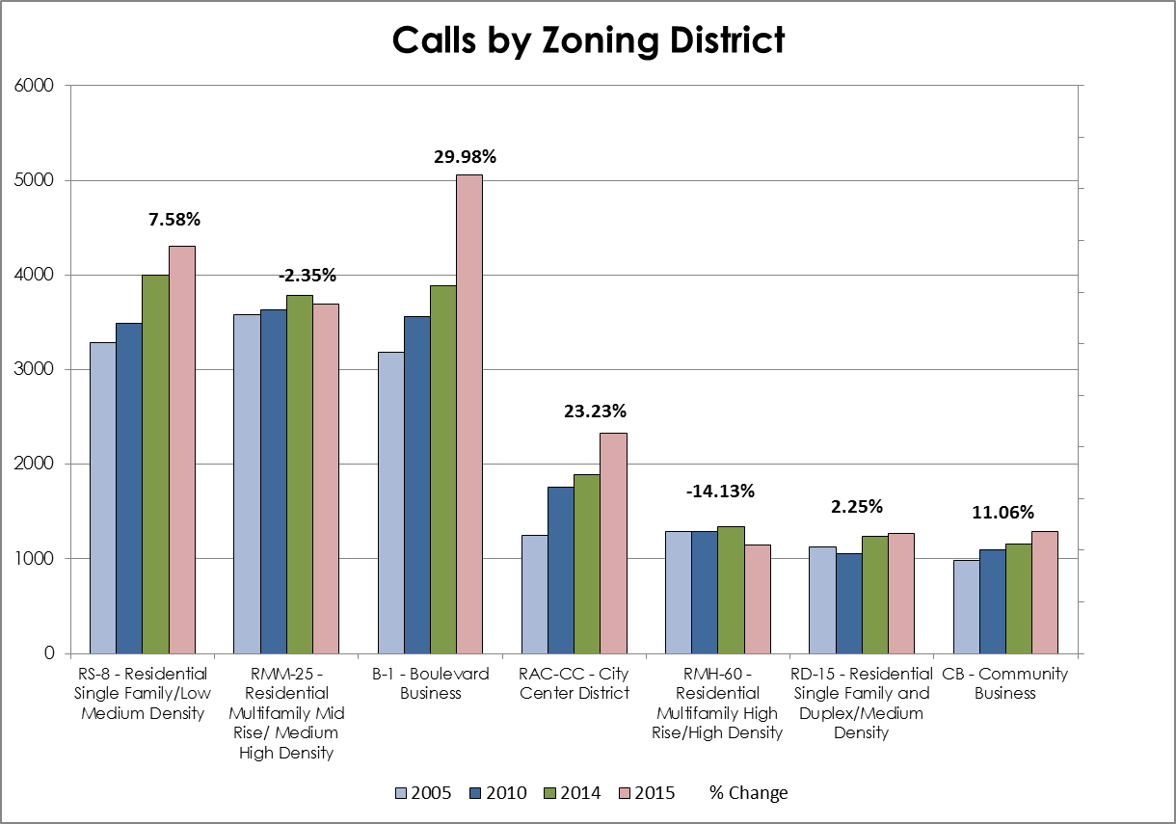
FireRMS Call Volumes – Zoning Type

Slide 26
FireRMS Call Volumes vs. City Services

Slide 27
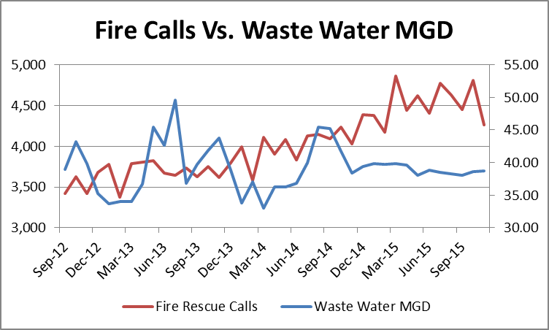
Calls vs. City Services

Slide 28
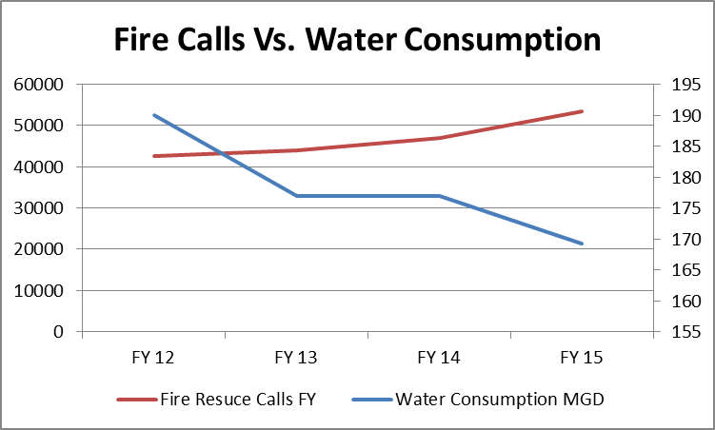
Calls vs. City Services

Slide 29
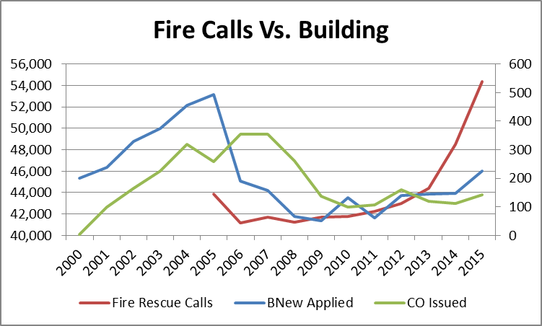
Calls vs. City Services

